Slide 1

WEB TECHNOLOGIES
Introduction to WWW,
Web Protocols and URLs
Vinay Joshi
Department of
Computer Science and Engineering

Slide 2

Introduction to WWW, Web Protocols and URLs
Common Terms
Internet vs. Web
Web Browsers
URL
Web Server
DNS
HTTP Protocol
HTTPS

Slide 3

Introduction to WWW, Web Protocols and URLs
Common Terms
What is Web Development?
Web development refers to the building, creating, and maintaining of websites. It includes aspects such as web design, web publishing, web programming, and database management. It is the creation of an application that works over the internet i.e. websites

Slide 4
Introduction to WWW, Web Protocols and URLs
What is Web Technologies?
Web Technology refers to the various tools and techniques that are utilized in the process of communication between different types of devices over the internet.
Web Technology can be classified into the following sections:
World Wide Web (WWW)
Web Browser
Web Server
Web Pages

Slide 5
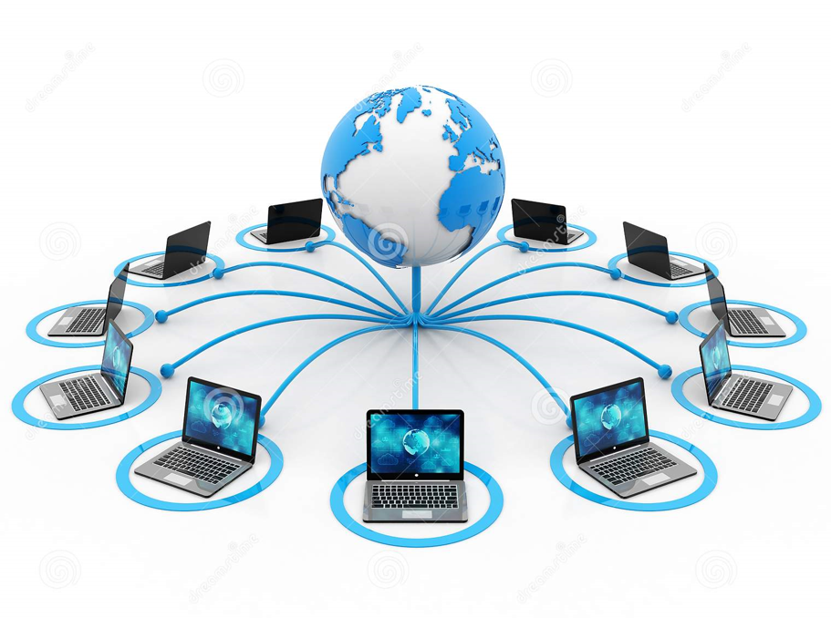
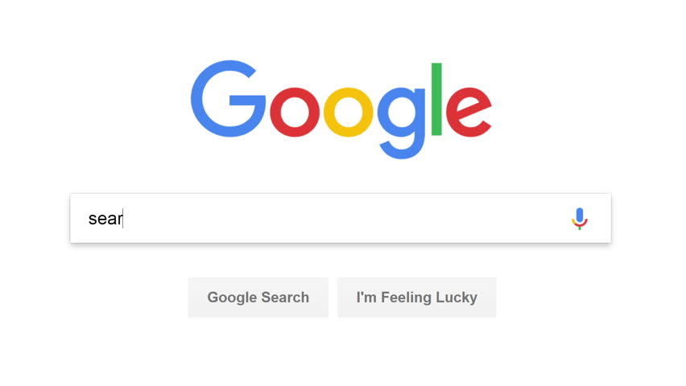
Introduction to WWW, Web Protocols and URLs
Internet vs. WWW

Slide 6
Introduction to WWW, Web Protocols and URLs
Internet vs. WWW
Internet is a means of connecting a computer to any other computer anywhere in the world.
World Wide Web which is a collection of information which is accessed via the Internet.
Internet is infrastructure.
WWW is service on top of that infrastructure.
Internet can be viewed as a big book-store.
Web can be viewed as collection of books on that store.
At some advanced level, to understand we can think of the Internet as hardware.
At some advanced level, to understand we can think of the WWW as software.

Slide 7
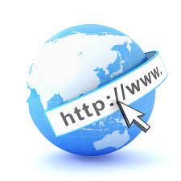
Introduction to WWW, Web Protocols and URLs
What is WWW?
The World Wide Web (WWW), commonly known as the Web, is the world's dominant software platform.
It is an information space where documents and other web resources can be accessed through the Internet using a web browser.
The Web has changed people's lives immeasurably.
It is the primary tool billions of people worldwide use to interact on the Internet.

Slide 8
Introduction to WWW, Web Protocols and URLs
What is WWW?
Features of WWW:
HyperText Information System
Cross-Platform
Distributed
Open Standards and Open Source
Uses Web Browsers to provide a single interface for many services
Dynamic, Interactive and Evolving.
“Web 2.0”

Slide 9
Introduction to WWW, Web Protocols and URLs
What is WWW?
Components of Web
Uniform Resource Locator (URL): serves as system for resources on web.
HyperText Transfer Protocol (HTTP): specifies communication of browser and server.
Hyper Text Markup Language (HTML): defines structure, organisation and content of webpage.

Slide 10
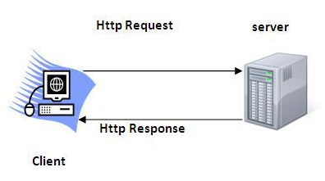
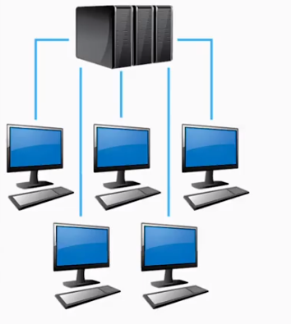
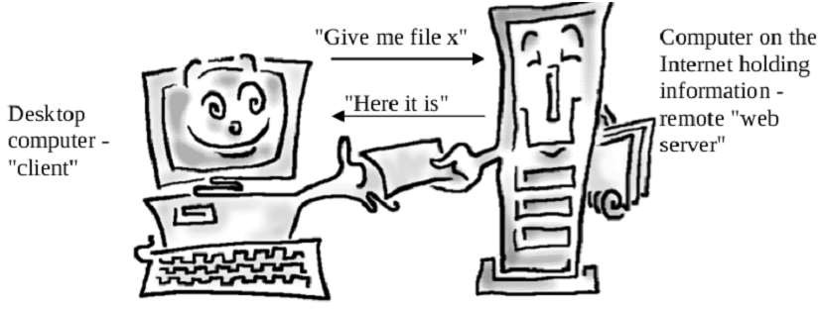
Introduction to WWW, Web Protocols and URLs
How does WWW work?
1. Client/Server Architecture
2. Request/Response Pattern

Slide 11
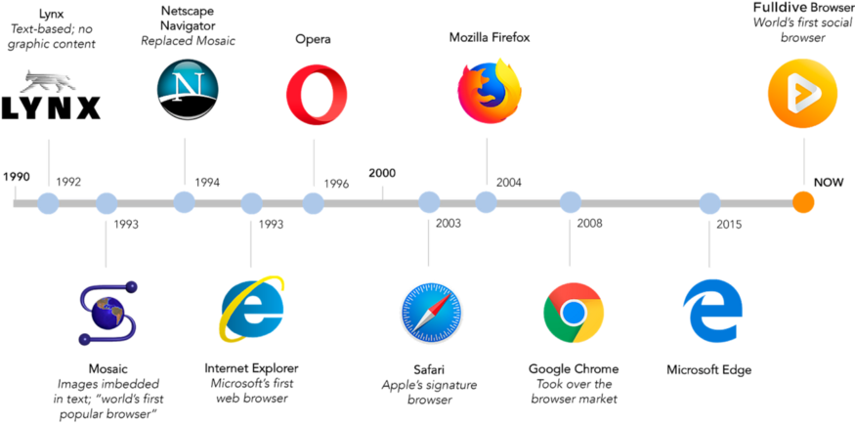

Introduction to WWW, Web Protocols and URLs
History of Web Browsers
2020
Microsoft Edge Based on chromium

Slide 12
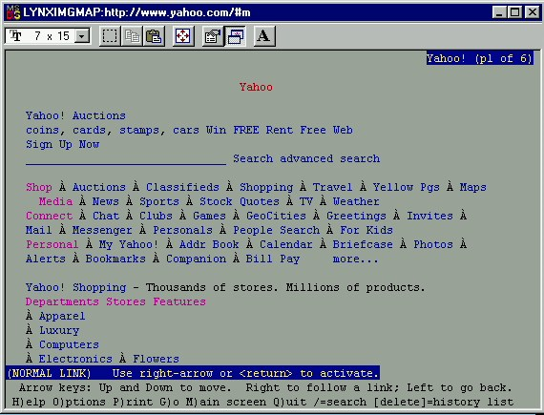
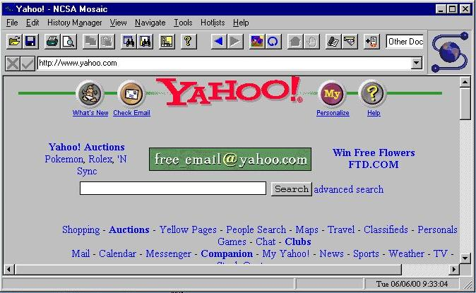
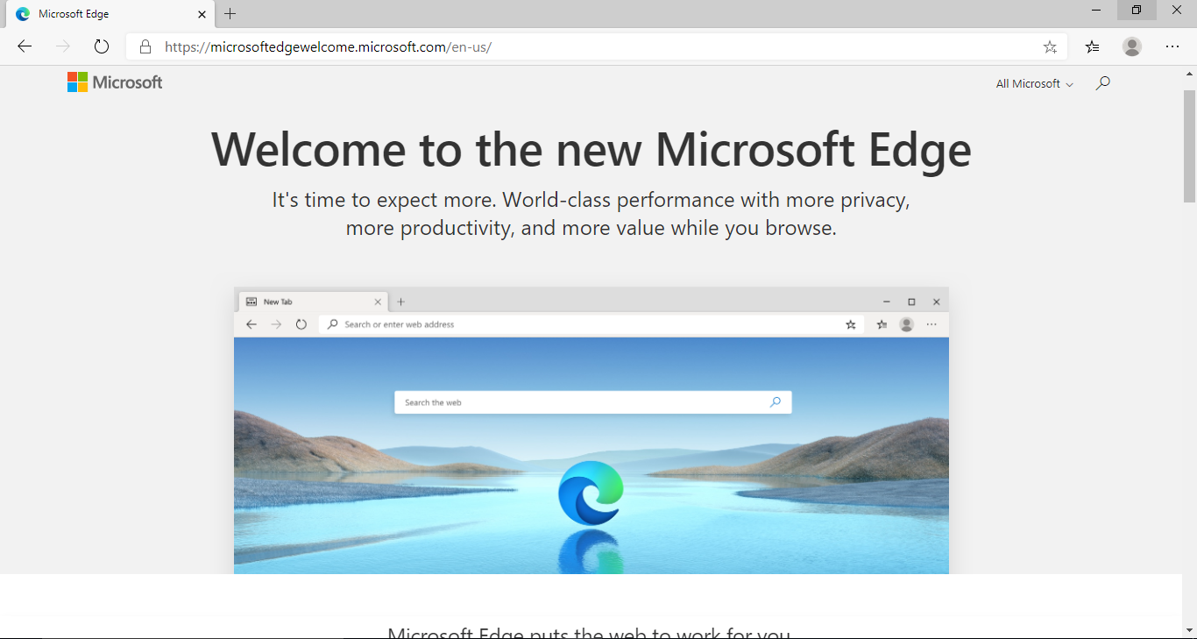
Introduction to WWW, Web Protocols and URLs
Browser Evolution
Lynx – A text based browser
Mosaic – the first graphical browser

Slide 13
Introduction to WWW, Web Protocols and URLs
URLs
URL stands for Uniform Resource Locator
General form:
scheme:object-address
For the http protocol, the object-address is:
fully qualified domain name/doc path
Example:
https://www.amazon.com/international-sales-offers.html

Slide 14
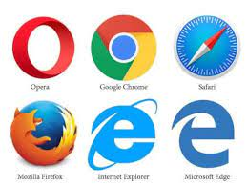
Introduction to WWW, Web Protocols and URLs
Web Browser
Web Browser is an Application program that displays a World wide web document. It usually uses the internet service to access the document.
The web browser act as an interface between the server and the client and displays a web document to the client.
The web browser sends an HTTP request and gets an HTTP response.
The web browser is installed on the client computer.

Slide 15
Introduction to WWW, Web Protocols and URLs
Web Server
Web server is a program or the computer that provide services to other programs called client.
The Web server accepts, approve and respond to the request made by the web browser for a web document or services.
The web server is a software or a system which maintain the web applications, generate response and accept clients data.
The web server gets HTTP requests and send HTTP responses.

Slide 16
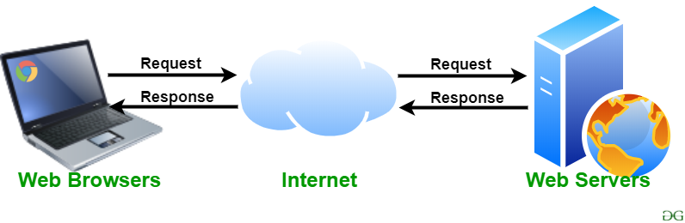
Introduction to WWW, Web Protocols and URLs
Web Server
Front End
Backend

Slide 17
Introduction to WWW, Web Protocols and URLs
Web Servers
Popular Examples
Apache
IIS

Slide 18
Introduction to WWW, Web Protocols and URLs
Web Servers
For example, you want to open Facebook on your laptop and enter the URL in the search bar of google.
Now, the laptop will send an HTTP request to view the facebook webpage to another computer known as the webserver.
This computer (webserver) contains all the files (usually in HTTP format) which make up the website like text, images, gif files, etc. After processing the request, the webserver will send the requested website-related files to your computer and then you can reach the website.

Slide 19
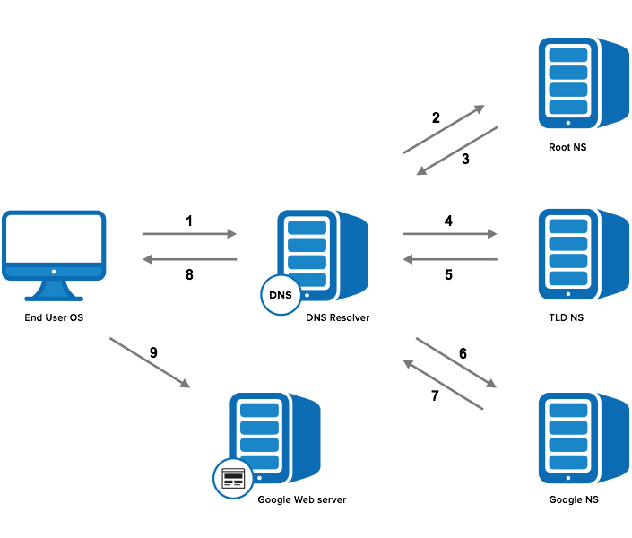
Introduction to WWW, Web Protocols and URLs
Domain Name Service
Step 1: OS Recursive Query to DNS Resolver
Step 2: DNS Resolver Iterative Query to the Root Server
Step 3: Root Server Response
Step 4: DNS Resolver Iterative Query to the TLD Server
Step 5: TLD Server Response
Step 6: DNS Resolver Iterative Query to the Google.com NS
Step 7: Google.com NS Response
Step 8: DNS Resolver Response to OS
Step 9: Browser Starts TCP Handshake

Slide 20
Introduction to WWW, Web Protocols and URLs
How to get your own website?
Steps:
1. Choose a domain name
2. Register a domain and sign up with web hosting
3. Set up a website using WordPress/Name cheap/Go Daddy (through web host)
4. Customize your website design and structure
5. Add pages and content to your website

Slide 21
Introduction to Web Protocols and HTTP
What is a Protocol?
A protocol is a system of rules that define how data is exchanged within or between computers.
Communications between devices require that the devices agree on the format of the data that is being exchanged.
The set of rules that defines a format is called a protocol.

Slide 22
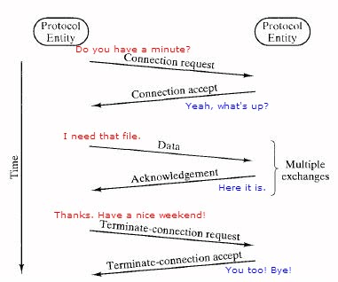
Introduction to Web Protocols and HTTP
What is a Protocol?
A protocol is a set of rules and guidelines for communicating data.
Different applications use different protocols
The web, in particular, uses multiple protocols to communicate.
The most important and visible protocols are HTTP and HTTPS.

Slide 23


Introduction to Web Protocols and HTTP
HTTP Overview
HTTP: HyperText Transfer Protocol
Application Protocol used by the Web
Client/Server model
Client: browser that requests, receives, and “displays” Web Objects
Server: Web server sends Web Objects (using HTTP protocol) in response to requests
server
running
Apache Web
server
HTTP request
PC running
Firefox browser
HTTP response
HTTP request
HTTP response
iphone running
Safari browser

Slide 24
Introduction to Web Protocols and HTTP
HTTP Request Structure
HTTP request is a request line, followed by zero or more request headers
Request line: <method> <uri> <version>
<version> is HTTP version of request
(HTTP/1.0 or HTTP/1.1)
<uri> is typically URL for proxies, URL suffix for servers.
<method> is either GET, POST, OPTIONS, HEAD, PUT, DELETE, or TRACE.
Request Header
Blank line (CRLF)
Message Body
GET /test.html HTTP/1.1
Accept: */*
Accept-Language: en-us
Accept-Encoding: gzip, deflate
User-Agent: Mozilla/4.0 (compatible; MSIE 4.01; Windows 98)
Host: euro.ecom.cmu.edu
Connection: Keep-Alive
CRLF (\r\n)

Slide 25
Introduction to Web Protocols and HTTP
HTTP Overview
HTTP stands for HyperText Transfer Protocol.
It is a protocol used to access the data on the World Wide Web (www).
The HTTP protocol can be used to transfer the data in the form of plain text, hypertext, audio, video, and so on.
This protocol is known as HyperText Transfer Protocol because of its efficiency that allows us to use in a hypertext environment where there are rapid jumps from one document to another document.
FTP,SMTP

Slide 26
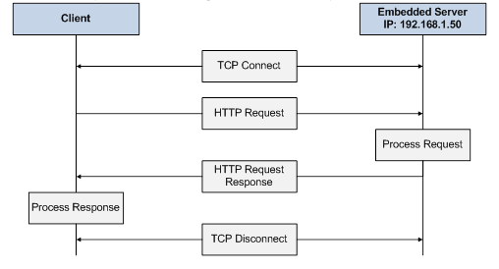
Introduction to Web Protocols and HTTP
HTTP Overview…(cntd.)
uses TCP:
client initiates TCP connection (creates socket) to server, port 80
server accepts TCP connection from client
HTTP messages (application-layer protocol messages) exchanged between browser (HTTP client) and Web server (HTTP server)
TCP connection closed
HTTP is “stateless”
server maintains no information about past client requests

Slide 27
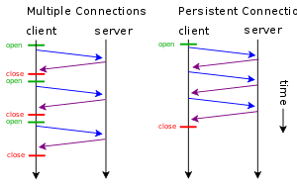
Introduction to Web Protocols and HTTP
HTTP Connections
non-persistent HTTP
at most one object sent over TCP connection
connection is then closed
downloading multiple objects required multiple connections
persistent HTTP
multiple objects can be sent over single TCP connection between client, server

Slide 28
Introduction to Web Protocols and HTTP
HTTP Request Methods
HTTP methods:
GET: Retrieve static or dynamic content
POST: Send content to server through request body
OPTIONS: Get server or file attributes
HEAD: Fetches only header field without any response body
PUT: Write a file to the server
DELETE: Delete a file on the server

Slide 29
Introduction to Web Protocols and HTTP
HTTP Response
HTTP/1.1 200 OK
Date: Thu, 22 Jul 1999 04:02:15 GMT
Server: Apache/1.3.3 Ben-SSL/1.28 (Unix)
Last-Modified: Thu, 22 Jul 1999 03:33:21 GMT
ETag: "48bb2-4f-37969101"
Accept-Ranges: bytes
Content-Length: 79
Keep-Alive: timeout=15, max=100
Connection: Keep-Alive
Content-Type: text/html
CRLF
<html>
<head><title>Test page</title></head>
<body>
<h1>Test page</h1>
</html>
HTTP response is a response line followed by zero or more response headers.
Response line:
<version> <status code> <status msg>
<version> is HTTP version of the response.
<status code> is numeric status.
Response headers:
<header name>: <header data>
Provide additional information about response
Content-Type: MIME type of content in response body.
Content-Length: Length of content in response body.

Slide 30
Introduction to Web Protocols and HTTP
HTTP Response : Status Codes
Three-digit number; first digit specifies the general status
1 => Informational
2 => Success
3 => Redirection
4 => Client error
5 => Server error
<status msg> is corresponding English text.
200 OK => Request was handled without error
403 Forbidden => Client lacks permission to access file
404 Not found => Server couldn’t find the file.

Slide 31
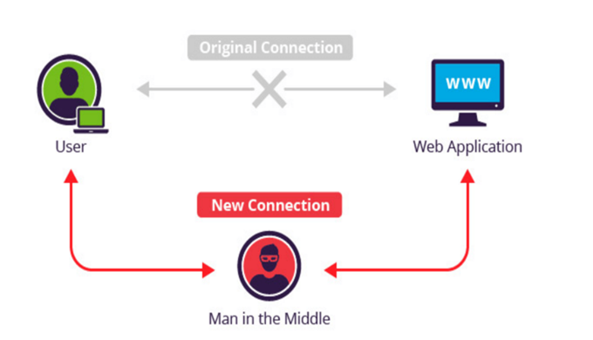
Introduction to Web Protocols and HTTP
HTTP Secure (HTTPS)
A common security attack
Need to encrypt data to save it from such attacks

Slide 32
THANK YOU
Vinay Joshi
Department of Computer Science and Engineering
vinayj@pes.edu
+91 80 2672 6622

